Slide 1
History of Bengal, 1204-1757: An overview
Dr. Buddha Dev Biswas
Deptartment of Social Science

Slide 2
Medieval Bengal, 1204-1757AD
Why 1204 AD and 1757 AD?
1204 AD: Bakhtiar Khalji defeated Laksmansena. So what?
1757 AD: Nawab Sirajuddowla was defeated by the English. So what?

Slide 3
Major sources of History:
Tabaqat-i-Nasiri a medieval text by Minhaj-i-Siraj. It is an important source book for the reconstruction of the history of foundation of Muslim rule in Bengal. The history of the first fifty years of Muslim rule in Bengal is found only in this text.
Riyaz-us-Salatin the first complete history of the Muslim rule in Bengal. Written in Persian language by Ghulam Husain Salim Zaidpuri, it covers the whole Muslim rule in Bengal from bakhtiyar’s conquest of Nadia in 1204-05 AD to the battle of palashi in 1757, though there are lacunae in various places.

Slide 4
tarikh-i-firuzshahis of Ziauddin Barani
Abul Fazl’s ain-i-akbari and akbarnamah
Badauni’s muntakhab-ut-tawarikh
Nizamuddin Bakhshi’s tabaqat-i-akbari

Slide 5
Medieval Bengal, 1204-1757AD
Three phases
Delhi Sultanate (1204-1342)
Independent Sultanate (1342-1538)
Mughal rule (1538-1757)

Slide 6
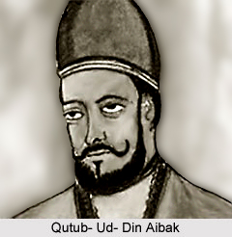
Medieval Bengal, 1204-1757AD
Quṭub Ud-Dīn Aibak (born 1150—died 1210), a founder of Muslim rule in India.
Delhi Sultanate (1204-1342)

Slide 7
Medieval Bengal, 1204-1757AD
Khilji Malik Dynasty
Mameluk Dynasty of Bengal
Balban Dynasty of Bengal

Slide 8
Medieval Bengal, 1204-1757AD
Ikhtiyar Uddin Muhammed Bin Bakhtiyar : conquest of Nadia.
Who was Bakhtiyar?
When was he invaded Bengal? 1203, 1204, or 1205?
Number of Soldiers accompanied him? 17 or 18 or more?
A disastrous campaign to Tibet in 1206 and its consequence

Slide 9
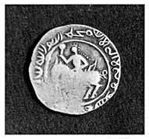
Silver coin of 'Ali Mardan (ca. 1208–13), commemorating the conquest of Bengal in A.H. Ramazan 600 (A.D. May 1204). Obverse only.

Slide 10
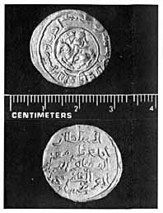
Gold coin of Muhammad Bakhtiar, struck in A.H. 601 (A.D. 1204–5) in Bengal in the name of Sultan Muhammad Ghuri. Obverse and reverse.

Slide 11
Medieval Bengal, 1204-1757AD
From rebel to rebel: Challenges for the successors
Muhammed Shiran Khilji (1206-1208 ): dethroned, fled and died
Hussamuddin Iwaj Khilji (1208-1210): dethroned
Ali Mardan Khilji (1210-1212): dethroned and murdered
Ghiyasuddin Iwaj Khilji (1212-1227): killed and his army routed.........Bengal was declared an province of the Delhi Sultanate, ushering in the Mamluk or Slave dynasty of Delhi.

Slide 12
Medieval Bengal, 1204-1757AD
Mameluk Dynasty of Bengal: Not so easy to rule in Bengal
Nasiruddin Mahmud: (1227-1229)
Malik Balkha Khilji or Daulat Shah Bin Maudud: (1229-1232)
Allauddin Jani: (1232-1233)
Saifuddin Aibak : (1233-1236)
Awar Khan Aibak : (1236)
Tughral Tughan Khan : (1236-1246)
Tughlaq Tamar Khan: (1246-1247)
Jalaluddin Masud Jani : (1247-1251)

Slide 13
Medieval Bengal, 1204-1757AD
Malik Ikhtiyaruddin Iuzbak: (1251-1257)
Ijjauddin Balban-e-Iuzbaki: (1257-1259)
Tatar Khan: (1259-1268)
Sher Khan: (1268-1272)
Mughisuddin Tughral : (1272 -1281 )

Slide 14
Medieval Bengal, 1204-1757AD
Balban Dynasty
Mahmud Shah also known as Naseeruddin Bughra Khan : (1281-1291)
Rukunuddin Kaikos : (1291-1300)
Shamsuddin Firoz : ( 1300-1322)
Ghiyasuddin Bahadur Shah I: (1322-1324-1328)

Slide 15
Fakhruddin Mubarak Shah (1338-1349): He was the founder of the earliest independent Muslim sultanat in Bengal with his headquerters at the historic city of Sonargaon.
He was the silahdar (superintendent of armoury) in the service of Bahram Khan, Tughlaq governor (wali) of Sonargaon.
In his coins, Fakhruddin is styled as Al-Sultan al-Azam Fakhr al-duniya wal-din AbuÕl Muzaffar Mubarak-shah al-sultan. (The great Sultan, Pride of the world and of the religion, Father of the conqueror, Mubarak Shah the sultan).

Slide 16
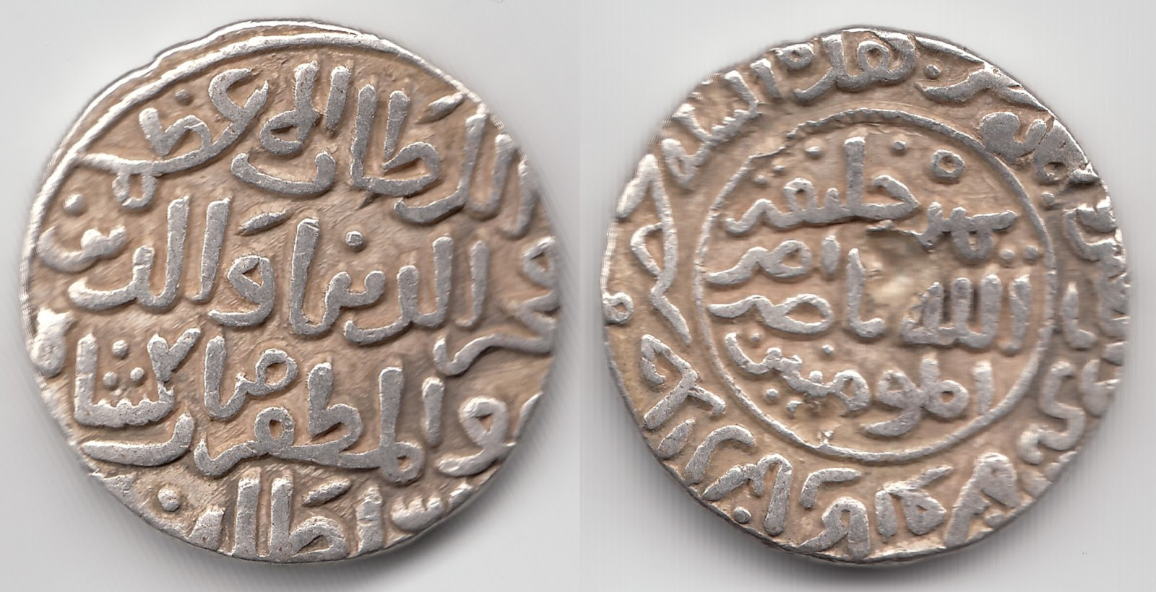
Fakhruddin Mubarak Shah 734-750 AH, 1333-1349 AD

Slide 17
Fakhruddin’s domination over the greater districts of Comilla, Noakhali, Sylhet and Chittagong naturally tightened his grip on the king of Tripura, and even the king of Arakan felt himself insecure for the south-eastward march of Fakhruddin, and is said to have courted alliance with the sultan of Sonargaon.
The Moroccan traveller Ibn Battuta visited Bengal (1346) during the reign of Fakhruddin Mubarak Shah. He has left a valuable account of his sojourn in the country of Bangalah, its natural view, different aspects on the life of the people and prosperity of the country.

Slide 18
Medieval Bengal, 1204-1757AD
For 200 years Bengal was independent
Iliyas Shahi dynasty (1342-1487) is first independent dynasty.
Alauddin Husain Shah founded Husain Shahi dynasty (1494-1538)

Slide 19
Medieval Bengal, 1204-1757AD
Iliyas Shahi dynasty (1342-1487)
-- Shamsuddin Iliyas Shah established power in Lakhnauti.
-- United Bengal (earlier divided in three parts)
-- Shah-I-Bangalah
-- Fakhruddin Mubarak Shah established power in Sonargoan
-- Ibn Batuta visited Bengal

Slide 20
Medieval Bengal, 1204-1757AD
Shamsuddin Ilyas Shah (1342–1358): from servant of Kader Khan (the ex governor of Lakhnauti) to independent ruler.
Sultan Firuz Shah Tughlaq Vs. Ilyas Shah
Sikandar Shah (1358–1390): son and successor of Ilyas Shah/ great Adina Mosque/ capable ruler/ was killed in a battle with his son
Ghiyasuddin Azam Shah (1390-1411): Foreign relations with China and Iran
Other rulers and glory

Slide 21
Medieval Bengal, 1204-1757AD
Raja Ganesha : 1415-1418
Jalaluddin Muhammad Shah: (1415-1433)
Msuddin Ahmad Shah: (1433-1436)
Ilyas Shah Dynasty Restored
Nasiruddin Mahmud Shah (1435 – 1459)
Rukunuddin Barbak Shah: (1459-1474
Shamsuddin Yousuf Shah: (1474-1481)
Sikander Shah II : (1481)
Jalaluddin Fateh Shah : (1481-1487)

Slide 22
Medieval Bengal, 1204-1757AD
Husain Shahi dynasty (1494-1538)
-- Alauddin was elected by nobles
--Territorial expansion (Tripura, CTG, Orissa etc)
-- Religious tolerance. Sri Chaitanna advocated Vaisnava religion.
-- Portuguese came in the 16th century.
-- Mughals started coming to borders of Bengal.

Slide 23
Medieval Bengal, 1204-1757AD
Nasiruddin Nusrat Shah (1519- 1532)
Alauddin Firuz Shah (1533)
Ghiyasuddin Mahmud Shah (1533-38)

Slide 24
Afghan Suri dynasty
Karrani Dynasty
Bengal under Mughal rule

Slide 25
Medieval Bengal (1204-1757)
Mughal Period (1576-1757)
-- Islam Khan Chisti defeated Bara Bhuiyans and transferred capital from Rajmahal to Dhaka.
-- Bara Katra built by Shah Shuja, son of Shahjahan.
-- Shaista Khan captured CTG and drove Magh pirates
-- Lalbagh fort
-- Eight maund rice in one Taka!!

Slide 26
Thank you
THANK YOU

